Slide 1
Communicators
iCAN personal goals
Milepost 2
Milepost 3

Slide 2
Communicators
At iCAN we are able to make our opinions and intentions clear and listen to the opinions and intentions of others. We are able to do this in lots of different ways – through spoken and written word, in different contexts and for different audiences.
iCAN personal goals

Slide 3
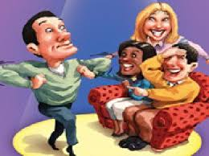
Communicators
Challenge 1: Charades
This is a great game for the whole family!
One person thinks of a book title, movie, play, song, famous person, or quote. Don’t tell anyone!
Now try to act it out (with no speaking) and the other people have to try to guess what you are acting.
Or watch this clip on how to play:
https://www.youtube.com/watch?v=5k046eyTqjo
iCAN personal goals

Slide 4
Communicators
Challenge 2: What’s in my bag?
Put different items into a small, dark bag. Then put your hand into the bag without looking and describe what you can feel. The other person playing can try to guess what it is.
iCAN personal goals

Slide 5
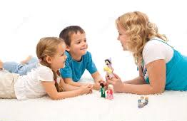
Communicators
Challenge 3: Finish the story
A great way to improve your communication skills is through story telling! Give each other the introduction to a story (could be about ANYTHING) and let the other person finish it however they like.
It is lots of fun and really improves our verbal communication skills as well as our story telling!
You could even challenge each other by
asking them to use connectives.
iCAN personal goals

Slide 6
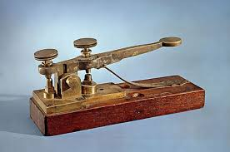
Communicators
Challenge 4: Communication before the internet
There were various forms of communication that were around even before the internet! Find out about one of them and create an A4 poster detailing what you have learned. Choose from: Morse code, telegraph, fax machine, or any other ancient technology that your family might know about…
iCAN personal goals

Slide 7
Communicators
Challenge 5: Talk for two
Together, make cards of your favourite topics (e.g. best ever meal; how to care for your pet) and place them in a bowl. Take it in turns to pick out a card and try speak on that topic for two minutes. With practice, you will find it gets easier and easier…then you can try more challenging topics!
iCAN personal goals

Slide 8
Communicators
Challenge 6: 20 questions
20 Questions is another great communication game. One person needs to think of a person, place or thing that the other has to guess. The guesser can ask 20 questions to identify the thing. The tricky bit? You can answer the questions with a simple ‘yes’ or ‘no’.
Don’t forget to let the other person have a turn!
iCAN personal goals

Slide 9
Communicators
Challenge 7: Write a letter
Is there someone you know that you haven’t spoken to in a long time? Maybe it’s a grandparent or an aunt? Or perhaps a friend from your old school. Or even someone that’s left iCAN and moved countries.
Now’s your chance to get in touch! If you know their address… send a letter! Getting a real letter in the post is such a thrill!
If not, maybe you can find out an email address?
iCAN personal goals

Slide 10
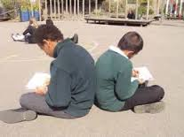
Communicators
Challenge 8: Back to Back
One person draws a simple drawing on a piece of paper. Do not show the other person. They then have to describe it the other person, who has to attempt to copy the drawing based only on the information given (no peeking!)
Compare drawings and swap roles.
iCAN personal goals

Slide 11
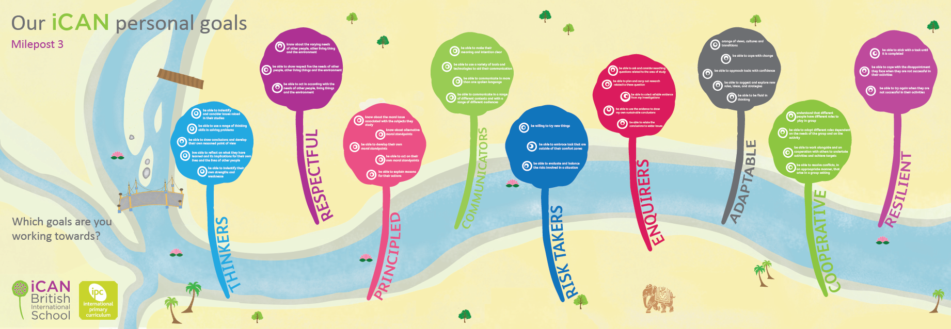
Communicators
Remember to share your personal goal challenges at:
padlet.com/ican/communicators
To inspire every child to recognise their full potential, believe they can make a difference and respect themselves, others and the world in which they live.

